Slide 1
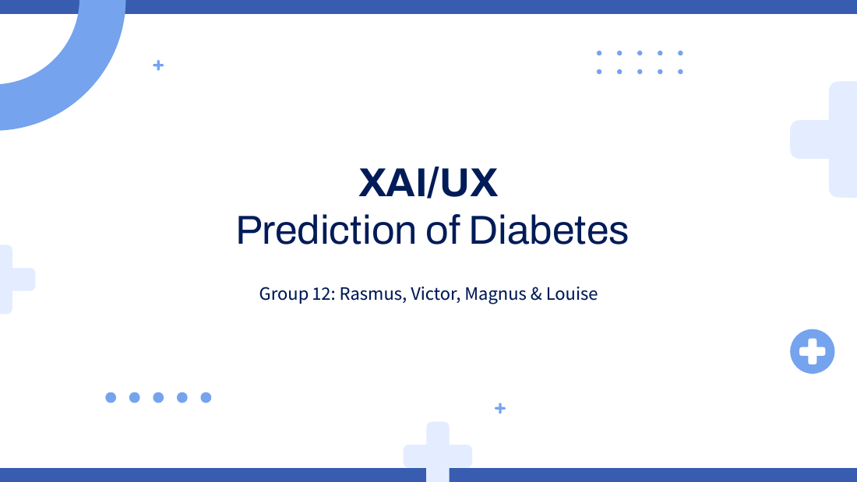
Director of the patient organization
XAI/UX
Evidence, reliability and a responsible next step
Group 12: Rasmus, Victor, Magnus & Louise
2 Director / 1
Notes:
L
TID: 30 sekunder.
8 slides på10minutter, efterfulgt af backup. Tal i almindeligt sprog og gør beslutningen konkret: støtte videre evaluering, ikke lancering som klinisk risikoværktøj.
Source: neural_network.ipynb, uploaded 19 Oct 2026. Saved outputs, not a new model run.
Source: decision_tree.ipynb, uploaded 19 Oct 2026. Saved outputs, not a new model run.

Slide 2
What the prototype measures
70,692 survey participants and 21 health indicators.
Two models classify reported prediabetes or diabetes.
The study deliberately includes equal numbers in each class.
2 Director / 2
Notes:
L
TID: 75 sekunder.
Forklar træ som faste spørgsmål og NN som lærte kombinationer. Begge er trænet på selvrapporteret diabetesstatus i en amerikansk2015-undersøgelse. Det er ikke fremtidig sygdom over et tidsinterval. Halvdelen af udviklingsdata har label1, hvilket ikke svarer til generel befolkning.
Source: neural_network.ipynb, uploaded 19 Oct 2026. Saved outputs, not a new model run.
Source: decision_tree.ipynb, uploaded 19 Oct 2026. Saved outputs, not a new model run.

Slide 3
The neural network makes fewer test errors
About 75 of 100
classified correctly
Neural network
in this test sample
About 73 of 100
classified correctly
Decision Tree
in this test sample
¹ Among 7,069 people with the label and among 7,070 people without it in percent.
2 Director / 3
Notes:
V
TID: 90 sekunder.
Holdt test på14.139. NN accuracy75.21, træ72.68. Formidl cirka75 versus73 korrekt pr100 i dette specifikke balancerede testdatasæt. Ingen signifikansanalyse. Vis begge typer fejl med præcise nævnere: blandt positive19.8% oversete NN 22.3 DT. Blandt negative29.8% falske alarmer NN32.4DT. Grafværdier beregnet fra gemte matricer, ikke simulerede data.
Source: neural_network.ipynb, uploaded 19 Oct 2026. Saved outputs, not a new model run.
Source: decision_tree.ipynb, uploaded 19 Oct 2026. Saved outputs, not a new model run.

Slide 4
One case illustrates both agreement and limits
Example person | Recorded information
Age / sex | 65–69 / female
Body mass index | 53
Blood pressure / cholesterol | Reported high
Actual survey status | Prediabetes or diabetes
Model scores | NN 0.8854 / tree 0.8526
Both identify this case correctly. Neither score establishes future risk.
2 Director / 5
Notes:
R
TID: 90 sekunder.
Case57608 er en positiv testperson, ikke en fejlcase. NN score.8854 tree.8526. Bevidst vises scores som0–1 og ikke personens risiko. Begge peger på højt BMI, blodtryk og generelt helbred. Rå værdier og vurdering af adgang: NoDocbcCost1 selvom AnyHealthcare1. Fremhæv adgangsbarrierer hvis direktøren spørger om produktets anvendelighed.
Source: neural_network.ipynb, uploaded 19 Oct 2026. Saved outputs, not a new model run.
Source: decision_tree.ipynb, uploaded 19 Oct 2026. Saved outputs, not a new model run.

Slide 5
The models use plausible health patterns
Most influential in the 40-person test sample | Neural network | Decision tree
General health | 1st | 1st
Body mass index | 2nd | 3rd
Age | 3rd | 5th
High blood pressure | 4th | 2nd
High cholesterol | 5th | 4th
Recognizable patterns support further investigation. They do not prove causation.
2 Director / 4
Notes:
M
TID: 90 sekunder.
Oversæt global rangorden, uden at kalde det kausalitet. NN: generelt helbred, BMI, alder, blodtryk, kolesterol. Tree: generelt helbred, blodtryk, BMI, kolesterol, alder. Global SHAP er kun 40 testpersoner og er derfor en indikation af modeladfærd, ikke dokumentation for hele populationen. Bedste fælles forklaring til direktør: modellerne finder genkendelige mønstre, men det beviser ikke klinisk værdi.
Source: neural_network.ipynb, uploaded 19 Oct 2026. Saved outputs, not a new model run.
Source: decision_tree.ipynb, uploaded 19 Oct 2026. Saved outputs, not a new model run.

Slide 6
Reliability has clear limits
Some people with the condition receive a low score.
The simple explanation differs from the NN score by 12.31 points on average for this case.
We have not established reliability across patient groups.
Results come from a balanced historical US sample.
2 Director / 6
Notes:
L
TID: 90 sekunder.
Skeln mellem model og forklaringskvalitet uden R². Cirka en ud af fem positive overses af NN. LIME gennemsnitlig absolut fejl ved samme person12.31pp over20runs. Det er fejl ved forklaringens approximation, ikke fejl i patientens faktiske risiko. Demografiske og sociale variable gør fairness-audit relevant, men notebooken dokumenterer ikke diskrimination eller fairness.
Source: neural_network.ipynb, uploaded 19 Oct 2026. Saved outputs, not a new model run.
Source: decision_tree.ipynb, uploaded 19 Oct 2026. Saved outputs, not a new model run.

Slide 7
A supervised evaluation is the next step
Before a patient-facing launch | Decision evidence needed
Representative evaluation | Performance and score calibration in the intended population
Clinical and fairness review | Acceptable missed cases and subgroup differences
Patient comprehension test | People understand uncertainty and appropriate next steps
Operational evaluation | Staff workload, access barriers and actual benefit
Proposal: fund evaluation. Current evidence does not justify clinical deployment.
2 Director / 7
Notes:
V
TID: 75 sekunder.
Dette er anbefalet næste fase, ikke udført arbejde eller en klinisk godkendelse. Først repræsentative nyere data og klinikerreview, derefter patientsikkerhed og brugertest. Brugertest undersøger om score fejllæses, om forklaring forstås, og om personen ved at tale med lægen. Ingen økonomiske besparelser eller dokumenteret effekt er målt.
Source: neural_network.ipynb, uploaded 19 Oct 2026. Saved outputs, not a new model run.
Source: decision_tree.ipynb, uploaded 19 Oct 2026. Saved outputs, not a new model run.

Slide 8
The decision for the organization
Continue development under supervision
The neural network is the stronger candidate in this test.
The tree helps us audit the reasoning.
Patient benefit and safe use still need direct evidence.
2 Director / 8
Notes:
R
TID: 60 sekunder.
Afslut ved10minutter. Anbefal NN som kandidat til videre evaluering på baggrund af dette testsæt, træ som transparent comparator. Ingen af modellerne godkendes som fremtidig risiko eller livsstilsrådgiver. Patientforklaringen skal være enkel, begrænset og vise næste skridt.
Source: neural_network.ipynb, uploaded 19 Oct 2026. Saved outputs, not a new model run.
Source: decision_tree.ipynb, uploaded 19 Oct 2026. Saved outputs, not a new model run.

Slide 9
Q&A: trust and business questions
Question | Evidence-based answer
Can we launch this for patients now? | Current evidence supports evaluation, not clinical deployment.
Will it reduce costs or prevent disease? | Neither outcome has been measured in this project.
Why choose the more complex model? | It has better observed test performance. We must still assess usability and safety.
Q&A backup / 9
Notes:
BACKUP: uden for de 10 minutter.
Svar uden AUC/R² medmindre direktøren beder om teknisk dokumentation.
Source: neural_network.ipynb, uploaded 19 Oct 2026. Saved outputs, not a new model run.
Source: decision_tree.ipynb, uploaded 19 Oct 2026. Saved outputs, not a new model run.

Slide 10
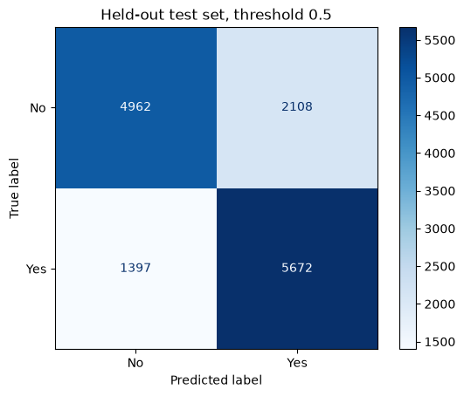

Backup: original test evidence
Neural network
Decision tree
Q&A backup / 10
Notes:
BACKUP: uden for de 10 minutter.
Originale notebook-matricer, som underbygger slide3. Behold nævnere tydelige. Forklar grøn/rød ikke nødvendig: de to off-diagonaler er fejl. NN TP5672 TN4962 og DT TP5495 TN4781.
Source: neural_network.ipynb, uploaded 19 Oct 2026. Saved outputs, not a new model run.
Source: decision_tree.ipynb, uploaded 19 Oct 2026. Saved outputs, not a new model run.

